Slide 1

Python Programming Unit 4 (KNC-302)
Prepared By
Abhishek Kesharwani
Assistant Professor,UCER Naini,Allahabad

Slide 2
UNIT IV
Sieve of Eratosthenes: generate prime numbers with the help of an algorithm given by the Greek Mathematician named Eratosthenes, whose algorithm is known as Sieve of Eratosthenes.
File I/O:
File input and output operations in Python Programming
Exceptions and Assertions.

Slide 3
Sieve of Eratosthenes
Algorithm to find all the prime numbers less than or equal to a given integer n by Eratosthenes’ method
Create a list of consecutive integers from 2 to n: (2, 3, 4, …, n).
Initially, let p equal 2, the first prime number.
Starting from p², count up in increments of p and mark each of these numbers greater than or equal to p² itself in the list. These numbers will be p(p+1), p(p+2), p(p+3).

Slide 4
Sieve of Eratosthenes
4. Find the first number greater than p in the list that is not marked. If there was no such number, stop. Otherwise, let p now equal this number (which is the next prime), and repeat from step 3.

Slide 5
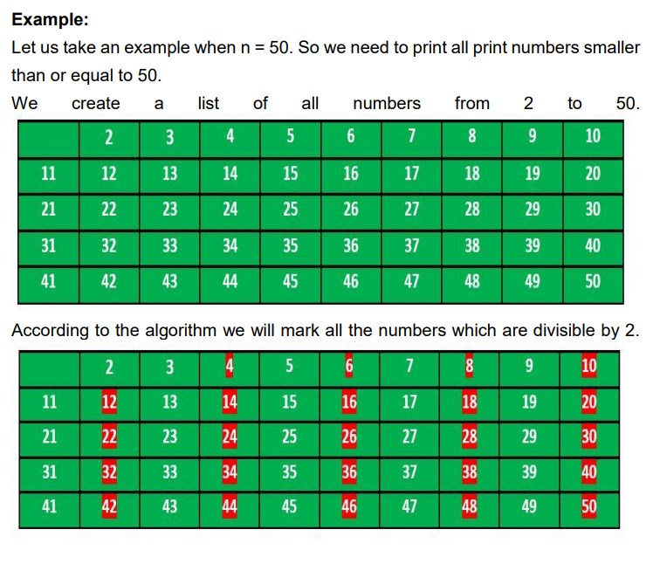

Slide 6
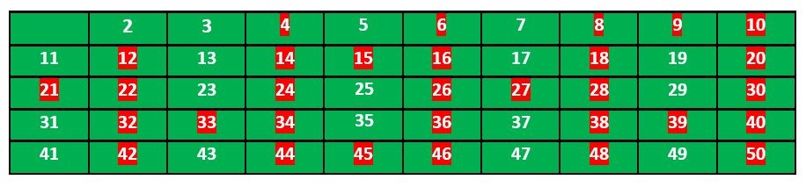
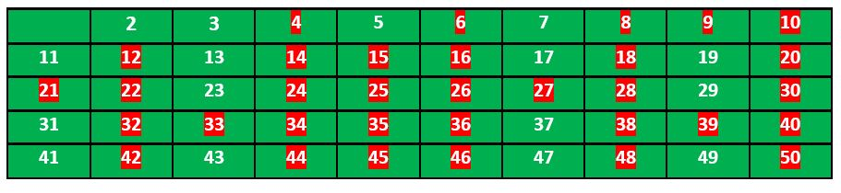
Now we move to our next unmarked number 3 and mark all the numbers which are multiples of 3 and are greater than or equal to the square of it.
We move to our next unmarked number 5 and mark all multiples of 5 and are greater than or equal to the square of it.

Slide 7
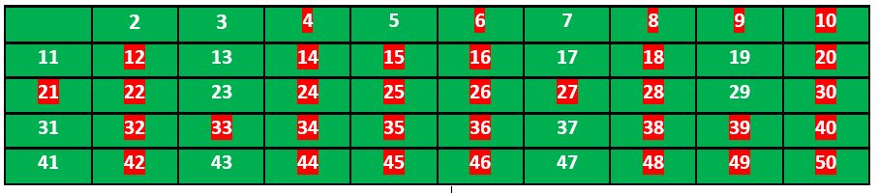
So the prime numbers are the unmarked ones: 2, 3, 5, 7, 11, 13, 17, 19, 23, 29, 31, 37, 41, 43, 47.

Slide 8
Sieve of Eratosthenes
def sieve(n): global primes primes=[True]*(n+1) primes[0]=False primes[1]=False for j in range(2,n+1): if primes[j]==False: continue for i in range (j*j,n+1,j): primes[i]=False

Slide 9
n=int(input('input n'))
sieve(n)
for i in range (2,n+1): if primes[i]: print(i,end=' ')

Slide 10
Output
input n 100
2 3 5 7 11 13 17 19 23 29 31 37 41 43 47 53 59 61 67 71 73 79 83 89 97

Slide 11
Python File Open
File handling is an important part of any web application.
Python has several functions for creating, reading, updating, and deleting files.
The key function for working with files in Python is the open() function.
The open() function takes two parameters; filename, and mode.

Slide 12
Create a New File
To create a new file in Python, use the open() method, with one of the following parameters:
"x" - Create - will create a file, returns an error if the file exist
"a" - Append - will create a file if the specified file does not exist
"w" - Write - will create a file if the specified file does not exist

Slide 13
There are four different methods (modes) for opening a file:
"r" - Read - Default value. Opens a file for reading, error if the file does not exist
"a" - Append - Opens a file for appending, creates the file if it does not exist
"w" - Write - Opens a file for writing, creates the file if it does not exist
"x" - Create - Creates the specified file, returns an error if the file exists

Slide 14
In addition you can specify if the file should be handled as binary or text mode
"t" - Text - Default value. Text mode
"b" - Binary - Binary mode (e.g. images)

Slide 15
Syntax
To open a file for reading it is enough to specify the name of the file:
f = open("demofile.txt")
f = open("demofile.txt", "rt")
Because "r" for read, and "t" for text are the default values, you do not need to specify them.
Note: Make sure the file exists, or else you will get an error.

Slide 16
Opening a file
Python provides the open() function which accepts two arguments, file name and access mode in which the file is accessed.
The function returns a file object which can be used to perform various operations like reading, writing, etc.

Slide 17
Example
#opens the file file.txt in read mode
fileptr = open("file.txt","r")
if fileptr:
print("file is opened successfully")

Slide 18
The close() method
Once all the operations are done on the file, we must close it through our python script using the close() method.
Any unwritten information gets destroyed once the close() method is called on a file object.

Slide 19
Reading the file
To read a file using the python script, the python provides us the read() method.
The read() method reads a string from the file. It can read the data in the text as well as binary format.

Slide 20
Example
fileptr = open("file.txt","r");
content = fileptr.read();
print(type(content))
print(content)
fileptr.close()

Slide 21
Read Only Parts of the File
By default the read() method returns the whole text, but you can also specify how many characters you want to return:
Example
Return the 5 first characters of the file:
f = open("demofile.txt", "r")
print(f.read(5))

Slide 22
Looping through the file
fileptr = open("file.txt","r");
for i in fileptr:
print(i) # i contains each line of the file
By looping through the lines of the file, you can read the whole file, line by line:

Slide 23
Write to an Existing File
To write to an existing file, you must add a parameter to the open() function:
"a" - Append - will append to the end of the file
"w" - Write - will overwrite any existing content

Slide 24
Delete a File
To delete a file, you must import the OS module, and run its os.remove() function:
Example
Remove the file "demofile.txt":
import os
os.remove("demofile.txt")

Slide 25
Check if File exist
import os if os.path.exists("ak123"): os.remove("demofile.txt") else: print("The file does not exist")
To avoid getting an error, you might want to check if the file exists before you try to delete it:

Slide 26
Delete Folder
To delete an entire folder, use the os.rmdir() method:
Example
Remove the folder "myfolder":
import os
os.rmdir("myfolder")

Slide 27
File Pointer positions
Python provides the tell() method which is used to print the byte number at which the file pointer exists.
Modifying file pointer position
In the real world applications, sometimes we need to change the file pointer location externally since we may need to read or write the content at various locations.
seek() method which enables us to modify the file pointer position externally.

Slide 28
Example
fileptr = open("file2.txt","r")
print("The filepointer is at byte :",fileptr.tell())
content = fileptr.read();
print("After reading, the filepointer is at:",fileptr.tell())

Slide 29
Output
The filepointer is at byte : 0
After reading, the filepointer is at 26

Slide 30
Modifying file pointer position
# open the file file2.txt in read mode
fileptr = open("file2.txt","r")
#initially the filepointer is at 0
print("The filepointer is at byte :",fileptr.tell())
#changing the file pointer location to 10.
fileptr.seek(10);
#tell() returns the location of the fileptr.
print("After reading, the filepointer is at:",fileptr.tell())

Slide 31
Output
The filepointer is at byte : 0
After reading, the filepointer is at 10

Slide 32
Exceptions
An exception can be defined as an abnormal condition in a program resulting in the disruption in the flow of the program.
Whenever an exception occurs, the program halts the execution, and thus the further code is not executed.
Therefore, an exception is the error which python script is unable to tackle with.
Python provides us with the way to handle the Exception so that the other part of the code can be executed without any disruption.

Slide 33
Common Exceptions
ZeroDivisionError: Occurs when a number is divided by zero.
NameError: It occurs when a name is not found. It may be local or global.
IndentationError: If incorrect indentation is given.
IOError: It occurs when Input Output operation fails.
EOFError: It occurs when the end of the file is reached, and yet operations are being performed.

Slide 34
Exception handling in python
If the python program contains suspicious code that may throw the exception, we must place that code in the try block.
The try block must be followed with the except statement which contains a block of code that will be executed if there is some exception in the try block.

Slide 35
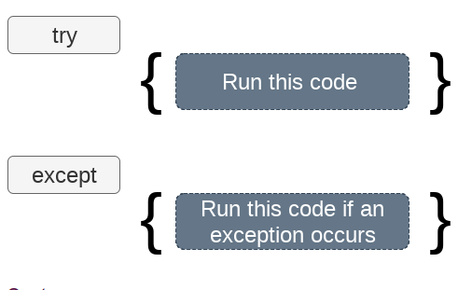

Slide 36
Syntax
try:
#block of code
except Exception1:
#block of code
except Exception2:
#block of code
#other code

Slide 37
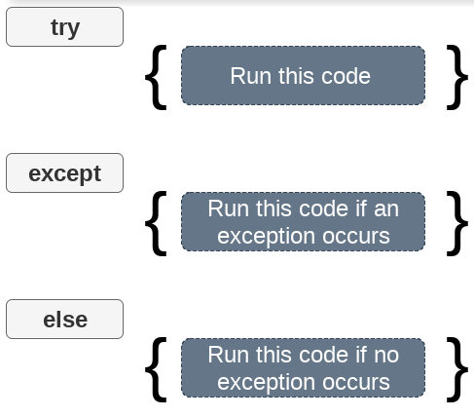

Slide 38
try except else
We can also use the else statement with the try-except statement in which, we can place the code which will be executed in the scenario if no exception occurs in the try block.

Slide 39
Example
try:
a = int(input("Enter a:"))
b = int(input("Enter b:"))
c = a/b;
print("a/b = %d“ %c)
except Exception:
print("can't divide by zero")
else:
print("Hi I am else block")

Slide 40
Output
Enter a:10
Enter b:2
a/b = 5
Hi I am else block

Slide 41
Points to remember
We can declare multiple exceptions in the except statement since the try block may contain the statements which throw the different type of exceptions.
We can also specify an else block along with the try-except statement which will be executed if no exception is raised in the try block.
The statements that don't throw the exception should be placed inside the else block.

Slide 42
Example
try:
#this will throw an exception if the file doesn't exist.
fileptr = open("file.txt","r")
except IOError:
print("File not found")
else:
print("The file opened successfully")
fileptr.close()

Slide 43
The finally block
We can use the finally block with the try block in which, we can place the important code which must be executed before the try statement throws an exception.

Slide 44
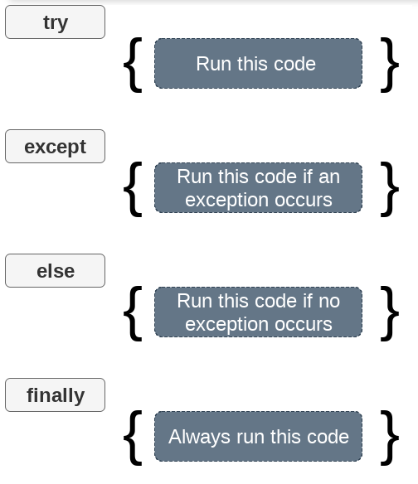

Slide 45
Example
try: a = int(input("Enter a:")) b = int(input("Enter b:")) c = a/b; print("a/b = %d"%c) except: print("can't divide by zero") else: print("Hi I am else block") finally: print("finally block is always executed")

Slide 46
Declaring multiple exceptions
try:
#block of code
except (<Exception 1>,<Exception 2>,<Exception 3>,...<Exception n>)
#block of code
else:
#block of code

Slide 47
Example
try:
a=10/0;
except ArithmeticError,StandardError:
print "Arithmetic Exception"
else:
print "Successfully Done"

Slide 48
Raising exceptions
An exception can be raised by using the raise clause in python. The syntax to use the raise statement is given below.
syntax
raise Exception_class,<value>

Slide 49
Example
try:
age = int(input("Enter the age?"))
if age<18:
raise ValueError;
else:
print("the age is valid")
except ValueError:
print("The age is not valid")

Slide 50
Example
try:
a = int(input("Enter a?"))
b = int(input("Enter b?"))
if b is 0:
raise ArithmeticError
else:
print("a/b = ",a/b)
except ArithmeticError:
print("The value of b can't be 0")

Slide 51
Output
Enter a 10
Enter b 0
The value of b can't be 0

Slide 52
Assertions
Assertions are statements that assert or state a fact confidently in your program.
For example, while writing a division function, you're confident the divisor shouldn't be zero, you assert divisor is not equal to zero.
Assertions are simply boolean expressions that check if the conditions return true or not.
If it is true, the program does nothing and moves to the next line of code.
However, if it's false, the program stops and throws an error.

Slide 53
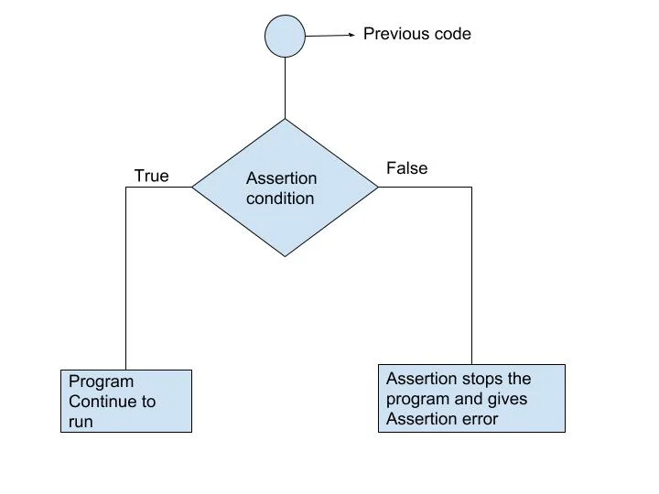

Slide 54
Python assert Statement
Python has built-in assert statement to use assertion condition in the program.
assert statement has a condition or expression which is supposed to be always true.
If the condition is false assert halts the program and gives an AssertionError.

Slide 55
Syntax for using Assert in Pyhton:
assert <condition>
assert <condition>,<error message>

Slide 56
def avg(marks): assert (len(marks) != 0,"List is empty.") return sum(marks)/len(marks) mark2 = [55,88,78,90,79] print("Average of mark2:",avg(mark2)) mark1 = [] print("Average of mark1:",avg(mark1))

Slide 57
Average of mark2: 78.0
AssertionError: List is empty.

Slide 58
Key Points to Remember
Assertions are the condition or boolean expression which are always supposed to be true in the code.
assert statement takes an expression and optional message.
assert statement is used to check types, values of argument and the output of the function.
assert statement is used as debugging tool as it halts the program at the point where an error occurs.

